Slide 1
Micromechanisms of Fracture

Slide 2
Outline
Introduction/ objectives
Types of fracture in metals
Fractographic observation in brittle fracture
Intergranular fracture
Theoretical cohesive strength of metals
The development in theories of brittle fracture
Ductile fracture
Ductile to brittle transition behaviour
Factors affecting modes of fracture

Slide 3
Objectives
This chapter presents:
the theories of brittle and ductile fractures together with the micromechanisms of fracture that might occur in metallic materials.
Factors affecting different types of fracture processes such as brittle cleavage fracture, ductile failure or intergranular fracture will be discussed.

Slide 4
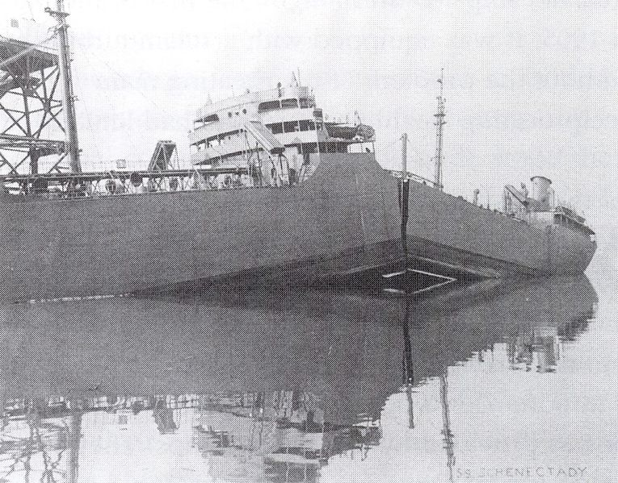
USS Schenectady

Slide 5
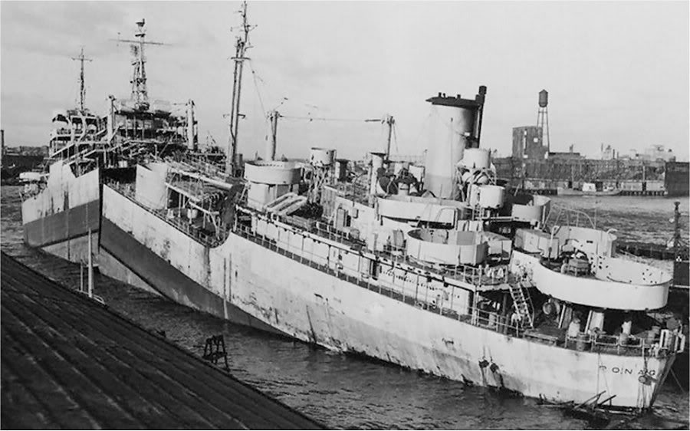
Failure of Liberty Ships
Add text
USS Ponaganset

Slide 6
Failure of Liberty Ships
Date: January 16, 1943
Location: Portland Oregon
Temperature: Water 29.2°F : Air 37°F
Construction: Welded
Material: Steel- type unknown
Significant Characteristics: Rapid construction, No Crack arresting plates, Inexperienced welders Poor construction quality
Point of Origin: Corners of Hatch opening,
Number of ships that failed; 1943 -20 1944- 120

Slide 7
Failure of Liberty Ships
Significant contributors to failure:
Poor quality steel
New construction methods (welding)-thought to be an unsuitable method of construction
Lack of knowledge of fracture characteristics of steel,
Cold, North sea water,
Overloading.

Slide 8
« Famous » failures and associated progresses

Slide 9
Types of Fracture in Metals
Materials strength and fracture resistance have been studied for a long time to overcome failures
The introduction of « malleable » irons during the evolution of material construction led to the perception of brittle and ductile fractures
Ductile fracture
Ductile fracture involves a large
amount of plastic deformation and
can be detected beforehand.
Failure in metallic materials can be divided into 2 main categories
Brittle fracture
Brittle fracture is more catastrophic
and has been intensively studied.

Slide 10
Brittle Fracture

Slide 11
Introduction
fcc metals: cross slip ⇒ (more or less) ductile fracture at any temperature
cc and hc metals: cleavage fracture at low temperatures (limited number of slip systems)
Intergranular fracture: presence of segregated species along grain boundaries

Slide 12
Cleavage (1)
Cleavage fracture along {100} planes in cc, {0001} planes in hc
Propagation perpendicular to the direction of the maximum principal stress

Slide 13
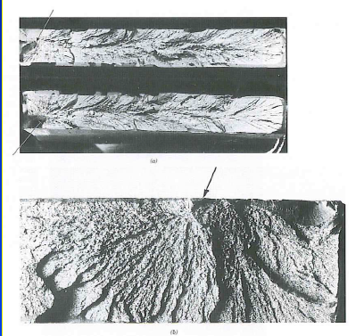
Fractographic observation of britle fracture by cleavage
The process of cleavage fracture
consists of three steps:
1) Plastic deformation to produce
dislocation pile-ups.
2) Crack initiation.
3) Crack propagation to failure.
Distinct characteristics of brittle:
1) The absence of gross plastic
deformation.
2) Grainy or faceted texture.
3) River marking or stress lines.
Brittle fracture indicating the origin of the crack and crack propagation path

Slide 14
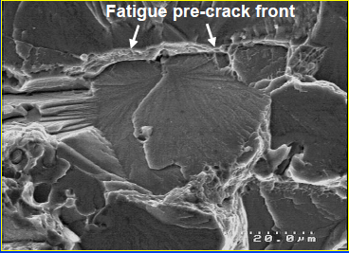
Cleavage fracture surface
• Cleavage fracture surface is
characterised by flat facets (with a size similar to the grain size).
The most favorable cleavage plane in an adjacent grain differs by a tilt or a twist angle.
• River lines or the stress lines are steps
between cleavage on parallel planes and always converge in the direction of local crack propagation.

Slide 15
Crack initiation from particles in cleavage fracture
Inclusions, porosity, second phase particles or precipitates are preferential sites (stress raiser)for cleavage initiation.
Fracture occurs along the crystallographic planes.
The direction of the river pattern represents the direction of the crack propagation.

Slide 16
Microstructural barriers
Initiation on second phase particle
Propagation within a ferrite grain
Crossing of grain boundaries
Initiation at a grain boundary by dislocation pile-up
Propagation within a ferrite grain
Crossing of a grain boundary
Depending on microstructure, cleavage can be controlled by nucleation of crack embryo or by the crossing of grain boundaries and subsequent propagation.

Slide 17
Intergranular fracture
• Intergranular failure is a moderate to low energy brittle fracture mode resulting
from grain boundary separation or segregation of embrittling particles or precipitates.
• Embrittling grain boundary particles are weakly bonded with the matrix, high free energy and unstable, which leads to preferential crack
propagation path.

Slide 18
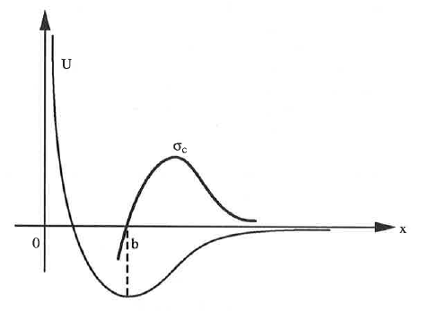
Theoretical cohesive strength of metals
The load to move the cleavage apart is determined by the derivative of the cohesion energy with respect to the displacement . Besides cleavage requires an energy corresponding to the creation of 2 new surfaces 2γ_{S}. This relation provides valus of the fracture strength that are several orders of magnitude higher than the values experimentally measured.

Slide 19
Theories of brittle fracture
Griffith theory of brittle fracture
The first analysis on cleavage fracture was initiated by Griffith using the concept of energy balance in order to explain discrepancy between the theoretical cohesive strength and observed fracture strength of ideally brittle material (cf. Fracture Mechanics course).
The development in cleavage fracture models
Modified Griffith theory by Irwin and Orowan.
Zener’s model of microcrack formation at a pile-up of edge dislocations.
Stroh’s model of cleavage crack formation by dislocation pile-up.
Cottrell’s model of cleavage crack initiation in BCC metals
Smith’s model of microcrack formation in grain boundary
carbide film.
Griffith (1920) The Phenomena of Rupture and Flow in Solids,
Philosophical Transactions of the Royal Society, A, 221, 163-198

Slide 20
Griffith Theory of Brittle Fracture
Observed fracture strength is always lower than theoretical cohesive strength: Griffith explained that the discrepancy is due to the inherent defects in brittle materials leading to stress concentration→ lower the fracture strength of the materials.
Crack propagation criterion: crack growth occurs when the released elastic strain energy is at least equal to the energy required to generate new crack surface
Plane stress
Plane strain

Slide 21
Modified Griffith Equation
The Griffith equation is strongly dependent on the crack size a,and theoretically satisfies only ideally brittle materials like glass.
However, metals are not ideally brittle and normally fail with certain amounts of plastic deformation, the fracture stress is increased due to blunting of the crack tip.
Irwin and Orowan suggested Griffith’s equation can be applied to materials that can withstand plastic deformation before brittle failure by including the plastic work, γ_{p}, into the total elastic surface energy required to extend the crack wall, giving the modified Griffith’s equation as follows:
Plane strain

Slide 22
Curry’s and Knott model for crossing microstructural barriers
Initiation takes place on second phase particle; crack then propagates until it is arrested at a microstructural barrier (Ex: propagation through bainitic laths and arrest on a grain boundary)
Unstable crack propagation is determined in the framework of brittle fracture mechanics: the crossing of the barrier occurs as soon as the most critical crack satisfies the Griffith criterion:
α: coeffcient dependent on the shape of the microcrack;
E: Young’s modulus;
γ_{m}: effective surface energy accounting for the plastic work dissipated during microcrack propagation;
a_{c}: critical length of a crack initiated

Slide 23
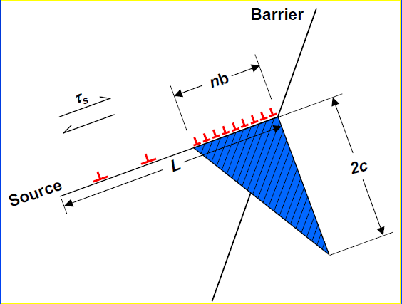
Zener’s model of microcrack formation at a pile-up of edge dislocations
The Griffith theory only indicates the stress required for crack
propagation of an existing crack of length 2a, but does not explain
the nucleation of the crack.
Zener and Stroh showed that the crack nucleation of length 2c
occurs when the shear stress τ_{s} created by pile-up of n dislocations
of Burgers vector b at a grain boundary reaches the value of:
Where τ_{i} is the lattice friction stress
in the slip plane.

Slide 24
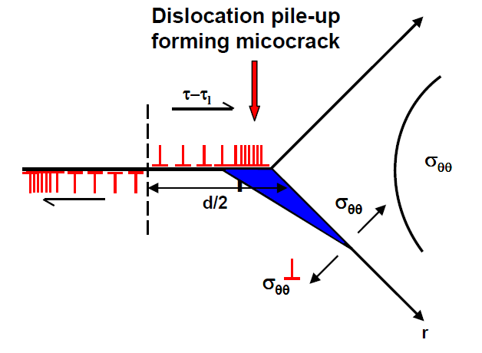
Stroh’s model of cleavage crack formation by dislocation pile-up
Stroh included the effect of the grain size d in a model, suggesting the condition of the shear stress created by dislocation pile-up of length d/2 to nucleate a microcrack as follows:
Where:
τ_{eff} is the effective shear stress
τ_{y} is the yield stress
Note: This model indicates that the fracture of the material should depend only on the shear stress acting on the slip band.
Stroh’s model of cleavage crack formation by dislocation pile-up.

Slide 25

Cottrell’s model of cleavage crack initiation in bcc metals
Cottrell later suggested that the fracture process should be controlled by the critical crack growth stage under the applied tensile stress, which requires a higher stress than the crack nucleation itself as suggested by Stroh.
Cottrell also showed that the crack nucleation stress can be small if the microcrack is initiated by intersecting of two low energy slip planes to provide a preferable cleavage plane.
Sir Alan Cottrell (1919-2012)

Slide 26
Cottrell’s model of cleavage crack initiation in bcc metals
This results in a wedge cleavage crack on the (001) plane. Further propagation of this crack is then controlled by the applied tensile stress.

Slide 27
Cottrell’s model of cleavage crack initiation in bcc metals
The dislocation created to minimize the energy is equivalent to a wedge of heigth nxb (n: number of dislocations, b: Burgers vector) and length 2a;
Cottrell calculates the critical energy required to create this sessile « superdislocation »
Instability analysis → critical cleavage stress σ_{c}
K_{y}: Hall-Petch constant
Such a dependence of the fracture stress with respect to the grain size is experimentally verified in some materials. However the experimental values identified for the coefficient leads to fracture energy that is much higher than 2γ_{S}. Furthermore this model is not adapted to microstructures where initiation takes place on second phase particles

Slide 28
Smith’s model of microcrack formation in grain boundary carbide film
Models proposed by Stroh and Cottrell involve crack initiation by dislocation pile-up of length D/2, but do not consider the role of second phase particles (cementite in mild steels for instance).
Smith then proposed a model for cleavage fracture in mild steel related to microcracking of grain boundary carbide by dislocation pile-up of length equal to half of the grain diameter d/2.
Microcrack is initiated when a sufficiently high applied stress causes local plastic strain within the ferrite grains to nucleate microcrack in brittle grain boundary carbide of thickness C₀.
Note: Further propagation of the GB carbide crack follows the Griffith theory.

Slide 29
Smith’s model of microcrack formation in grain boundary carbide film
When the term related to dislocation pile-up is neglected, the criterion for propagation based on critical stress is similar to Griffith criterion

Slide 30
Smith’s model of microcrack formation in grain boundary carbide film
At the flow stress, using the Hall-Petch relation, it appears that the ferrite grain does no longer intervene in the formula while experimental data indicate that te cleavage strength in mild steels depends on d^{1/2}.
However it has been shown that these parameters are not disconnected; indeed a fine grain size is associated to small carbides.

Slide 31
RKR model
The model proposed by Ritchie, Knott and Rice tries to relate the critical stress σ_{c} to the fracture toughness K_{Ic}.
In this model, fracture occurs when the maximum principal stress reaches the critical stress value at a distance equal to L₀ from the crack tip.
σ_{c} and L₀ do not depend on temperature;
K_{Ic} depends on yield stress σ_{y} and therefore on temperature;
At low temperatures, lower stresses are required to reach the critical stress value and vice versa;
β: amplitude of the stress singularity;
n: strain hardening coefficient

Slide 32
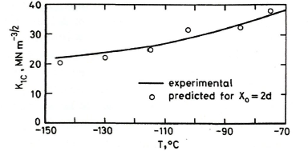
RKR model
L₀ ~ 2 x grain size d
L₀ and σ_{c} have to be derived from experimental data;

Slide 33
Weakest link theory
In a given material, the stressed region (volume V) is divided into N elements (volumeV₀).
Each volume is submitted to a homogeneous stress σ_{i} and the probability of failure is p₀(σ_{i});
The probabability of failure of the total volume is:
If the stress σ and the failure probability p₀(σ)are the same in each elementary volume,
If the stress is not homogenous over the volume V

Slide 34
Weibull theory
In Weibull’s model the material is assumed isotropic and statistically homogeneous
Weibull proposed an empirical relationship:
σ₀ : threshold stress (σ₀ below no failure), σ_{u} normalising stress.

Slide 35
Comments on Weibull’s model
Weibull’s model is intrinscially based on probability and macroscopic;
It recognises the presence of defects and their role as a source of failure, but does not directy consider this presence;
The model adresses the consequence of the presence of defects but not to the root cause of these defects;
It does not consider the distribution, orientation, nature of defects and the stress field;
However this model is simple, with 2 parameters that can be easily experimentally determined on the basis of fracture data;
It can account for the scatter in fracture data in a wide range of materials (not only in metals!) for simple sollicitations

Slide 36
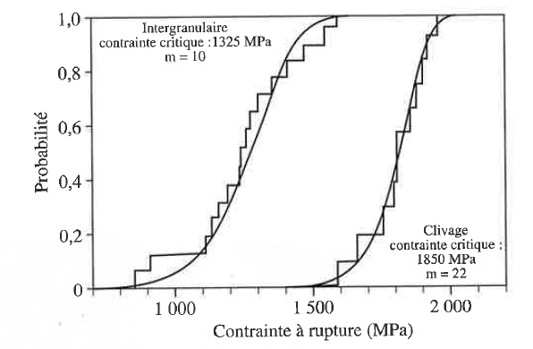
Competition between intergranular fracture and cleavage
16MND5
Intergranular fracture not only occurs at lower stress but the dispersion is also larger,as indicated by the m value

Slide 37
Competition between intergranular fracture and cleavage
Grain boundaries, joining two desoriented lattices, have their cohesion energy γ_{GB} function of the disorientation.
When failure occurs along a grain boundary, this energy has to be substracted to the fracture energy 2γ_{s}.
While the anisotropy of fracture energy has to be taken into account, the cleavage fracture energy is lower than the grain boundary failure energy. One can consider that they are in a ratio of 1.2.
Intergranular failure will occur if R_{CI} is lower than 1, where R_{CI} is defined as:

Slide 38
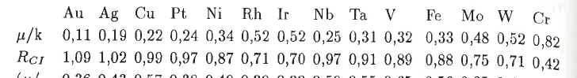
Competition between intergranular fracture and cleavage
According to Cottrell, the ratio γ_{GB}/γ_{Sc} is related to the ratio μ/k (μ: shear modulus; k: compressibility modulus).
Detailed calculation in pure Nickel yield: α=0.95.

Slide 39
Ductile Failure

Slide 40
Introduction
Ductile fracture is a much less serious problem in engineering materials since failure can be detected beforehand due to observable plastic deformation prior to failure.
Under uniaxial tensile force, after necking, microvoids form and coalesce to form crack, which then propagate in the direction normal to the tensile axis.
The crack then rapidly propagate through the periphery along the shear plane at 45°, leaving the cup and cone fracture.
Definition: Fracture under continuously increasing stressing, distinguished by purely mechanical nucleation, growth, coalescence of microscopic voids, typically at 2nd phase particles

Slide 41
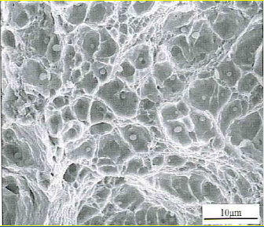
Microvoid formation, growth and coalescence
Microvoids are easily formed at inclusions, intermetallic or second-phase particles and grain boundaries.
Growth and coalescence of microvoids progress as the local applied load increases.
Ductile dimples centred on spherical particles

Slide 42
Stages of dimpled fracture with increased deformation
Nucleation
Particles
Large=1-25 μm constituents or inclusions (impurity)
Intermediate=0.5 to 5 μm dispersoids (desirable)
Small=50 to 500 Å precipitates (desirable)
Growth
Coalescence
Mainly on σ_{y}

Slide 43
Formation of microvoids from second phase particles
Microvoids are formed by:
1) Decohesion at particle-matrix interface.
2) Fracture of brittle particle
3) Decohesion of an interface associated with shear deformation or grain boundary sliding.
Fractured carbides aiding microvoid formation.
Mechanisms of microvoid formation
Decohesion of carbide particles from Ti matrix.

Slide 44
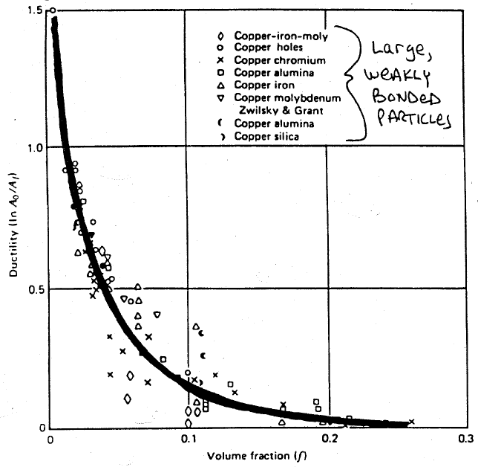
Role of 2nd phase particles
True fracture stress and strain decrease when the volume fraction of 2nd phase particles increases
The yield strength is not affected by such particles

Slide 45
Role of 2nd phase particles
Carbides in iron
Voids in Copper
Dispersoids in Al
Constituents in 7075
Inclusions in steels

Slide 46
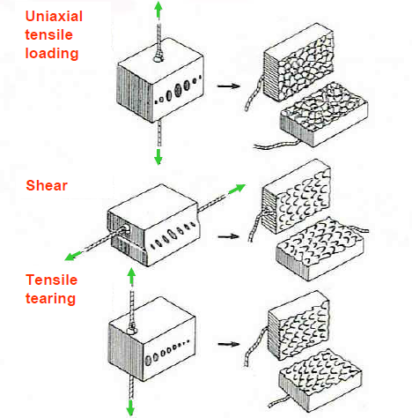
Microvoid shape
Microvoid shape is strongly influenced by the type of loading.
Uniaxial tensile loading → Equiaxed dimples
Shear → Elongated and parabolic dimples pointing in the opposite directions on matching fracture surfaces
Tensile tearing → Elongated dimples pointing in the same direction on matching fracture surface

Slide 47
Ductile fracture resistance
Depends on:
Particle volume fraction
Particle size
Particle spacing (α size/f_{v}^{1/3})
Particle ductility
Particle shape
Particle-matrix interface strength
Matrix work hardening
Deformation mode
Presence of intermediate size particles

Slide 48
Ductile to brittle transition
bcc metals experience ductile-to-brittle transition behaviour when subjected to decreasing temperature (and/or high strain rate), resulting from a strong yield stress dependence on temperature.
bcc metals possess limited slip systems available at low temperature, minimising the plastic deformation during the fracture process.
Increasing temperature allows more slip systems to operate, yielding general plastic deformation to occur prior to failure.

Slide 49
Example: influence of ageing on the DBTT of a nuclear reactor vessel steel

Slide 50
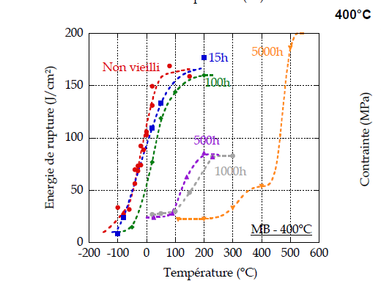
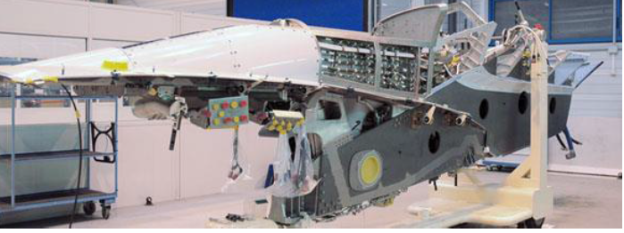
Exemple: influence of ageing on DBTT in a martensitic stainless steel

Slide 51
Ductile to Brittle Transition in smooth specimens
When temperature is lowered, the flow stress increases. Meanwhile, the cleavage critical stress is much less temperature-sensitive. The curves describing their temperature dependence crosses at a temperature T_{D}. Just above this temperature, during loading, the material first deforms plastically and work hardening is initiated. Cleavage occurs when the stress reaches σ_{f}. Elongation at failure thus increases as the difference between σ_{f} and R_{p} is getting larger. Below T_{D} failure occurs before reaching the flow stress and elongation at failure is nul. T_{D} is the temperature for no ductility on smooth specimens.

Slide 52
Relation between fracture stress and yield strength at low temperature
Mild steel
(after Low)

Slide 53
Theory of the ductile to brittle transition
The criterion for a material to change its fracture behaviour from ductile to brittle mode is when the yield stress at the observed temperature is larger than the stress necessary for the growth of the microcrack indicated in the Griffith theory.
Cottrell studied the role of parameters, which influence the ductile-to-brittle transition as follows:
τ_{i} is the lattice resistance to dislocation movement;
k’ is a parameter related to the release of dislocation into a pile-up;
D is the grain diameter (associated with slip length);
G is the shear modulus;
β is a constant depending on the stress system.
The criterion for ductile to brittle transition is when the term on the left hand side is greater than the right hand side

Slide 54
Factors affecting ductile to brittle transition
From equation, materials having high lattice resistance τ_{i} , grain size D and k’ has a high tendency to become brittle with decreasing temperature.
The τ_{i} term in bcc material is strongly dependent on temperature.
Materials with high k’ i.e., Fe and Mo are more susceptible for brittle fracture.
Smaller grain sized metals can withstand brittle behaviour better
Alloy chemistry and microstructure also affect the ductile-to-brittle transition behaviour.

Slide 55
Factors affecting ductile to brittle transition
Effect of grain size on the yield and fracture stresses for a low-carbon steel tested in tension at -196°C.

Slide 56
Influence of grain size on DBTT
The most important metallurgical parameter is the grain size. A smaller grain size induce a higher yield strength according to Hall-Petch law, but also influences the cleavage critical stress. The result is a lower DBTT

Slide 57
Influence of Ni content on DBTT in steels
Elements such as Ni, by lowering the temperature for austenite transformation, promote the formation of small grains/ therefore they induce a lower DBTT.

Slide 58
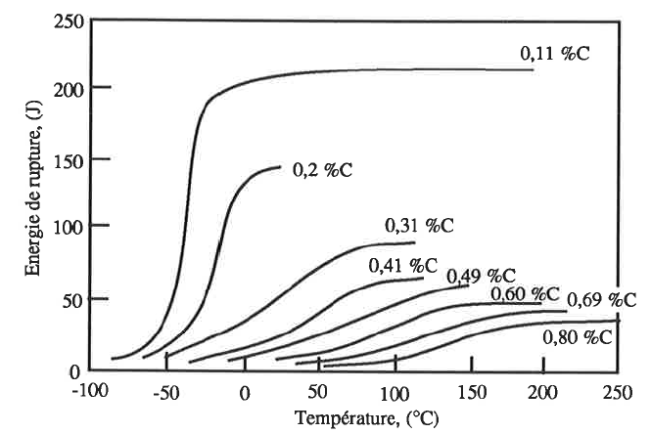
Influence of interstitials on DBTT
Interstitials such as C or N, by increasing the σ₀ term in Hall-Petch relation, make the yield strength to increase and the DBTT. They furthermore affect the ductile plateau.

Slide 59
Notch effect on transition temperature
The fracture stress σ_{f} is much less temperature sensitive than the flow stress σ₀.
The σ₀ of the unnotched specimen is lower than σ_{f} at temperatures above the transition temperature.
The metal therefore deforms plastically before fracture. Below the transition temperature σ₀ > σ_{f} , metal fails without plastic deformation.
The presence of the notch raises the σ_{o} by the plastic constraint factor q. This shifts the transition temperature to the right hand side.

Slide 60
Influence of stress triaxiality
In a notch specimen, as far as the gross stress is lower than the yield strength, the maximum of stress is located at the notch root (stress concentration)
The yield strength is first reached in this site. During further loading, plasticity spreads from the notch root. The load required to spread placticty across the entire section is generally much larger than the load that would be applied on a smooth specimen of the same section.
The triaxiality rate can reach very high values

Slide 61
Notched specimens: Bridgman’s analysis
Hyp: radial and hoop strains are equal and homogeneous in the minimum section area ⇒ σ_{rr}=σ_{θθ}
Notch or necking

Slide 62
Notched specimens: Bridgman’s analysis

Slide 63
Metallurgical aspects of fracture
There are microstructural features that can play a role in determining the fracture path, the most important are:
Second phase
Particles and precipitates
Grain size
Fibering and texturing
High strength materials usually possess several microstructural features in order to optimise mechanical properties by influencing deformation behaviour / fracture paths.

